Slide 1
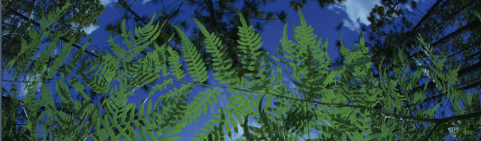



Data Cleaning Overview
Pam Soltis
University of Florida
BiotaPhy

Slide 2
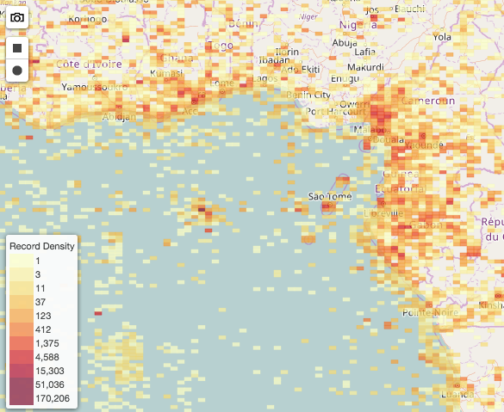
Occurrence Data Cleaning
Resolve taxon names
Decrease number of columns
Remove duplicates
Clean localities
Round up the latitude/longitude
Remove coordinates at 0,0
Remove coordinates in cultivated zones, botanical gardens, etc.
Remove coordinates outside of the desired range
Spatial correction
Produce a csv

Slide 3
Occurrence Data Cleaning
Resolve taxon names
Decrease number of columns
Remove duplicates
Clean localities
Round up the latitude/longitude
Remove coordinates at 0,0
Remove coordinates in cultivated zones, botanical gardens, etc.
Remove coordinates outside of the desired range
Spatial correction
Produce a csv

Slide 4
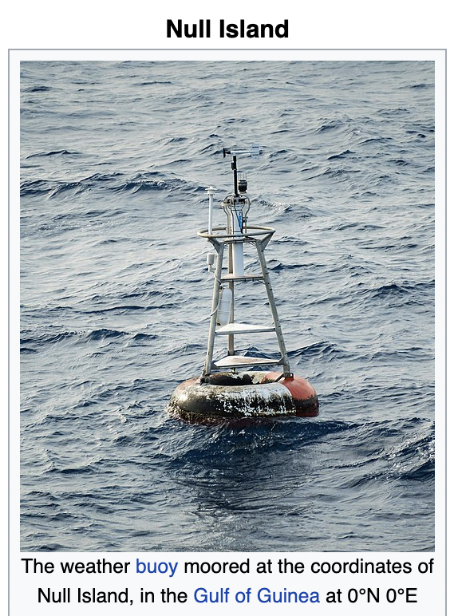
Occurrence Data Cleaning
Resolve taxon names
Decrease number of columns
Remove duplicates
Clean localities
Round up the latitude/longitude
Remove coordinates at 0,0
Remove coordinates in cultivated zones, botanical gardens, etc.
Remove coordinates outside of the desired range
Spatial correction
Produce a csv

Slide 5
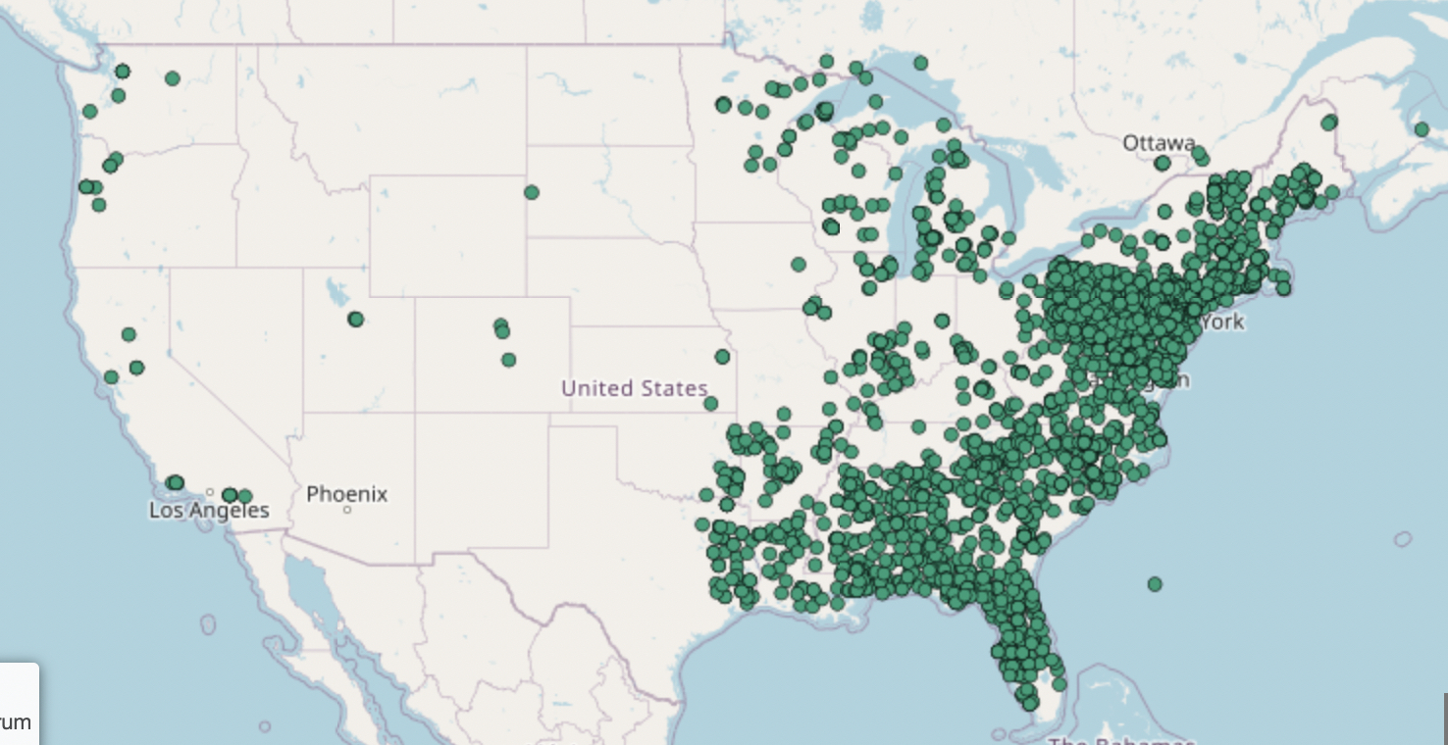
Occurrence Data Cleaning
Resolve taxon names
Decrease number of columns
Remove duplicates
Clean localities
Round up the latitude/longitude
Remove coordinates at 0,0
Remove coordinates in cultivated zones, botanical gardens, etc.
Remove coordinates outside of the desired range
Spatial correction
Produce a csv

Slide 6
Occurrence Data Cleaning
Resolve taxon names
Decrease number of columns
Remove duplicates
Clean localities
Round up the latitude/longitude
Remove coordinates at 0,0
Remove coordinates in cultivated zones, botanical gardens, etc.
Remove coordinates outside of the desired range
Spatial correction
Produce a csv

Slide 7
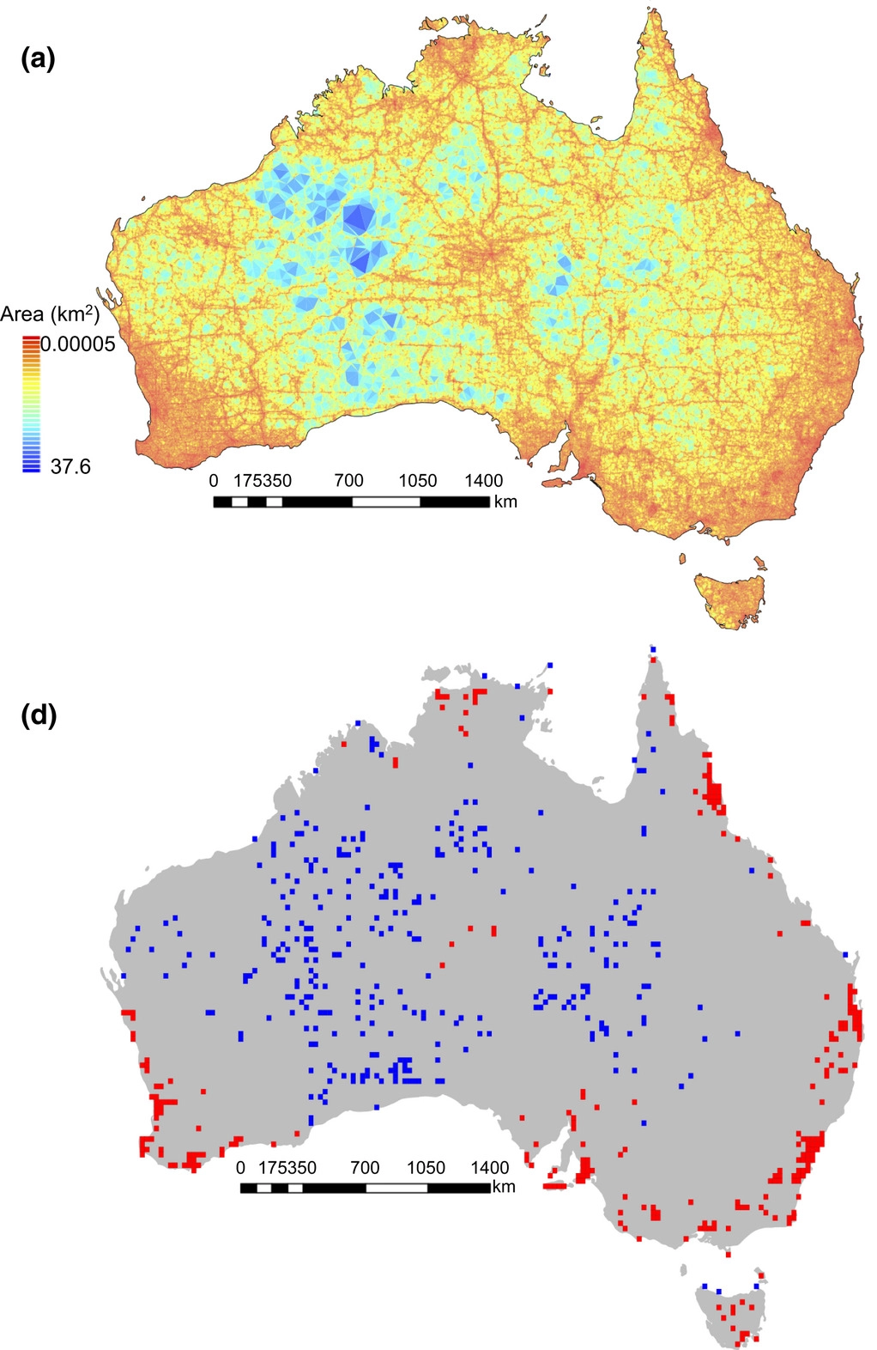
Spatial Correction
Sampling bias for
857,245 records
Sampling bias for
857,245 sites
Collection efforts can lead to clustering of points
Infrastructure (roads, herbaria, etc.)
Taxon bias
Temporal bias
Filtering is a procedure to reduce the clustering of species records
Density of sampling sites
Daru et al. 2018. Widespread sampling biases in herbaria revealed from large-scale digitization. New Phytologist.
# specimens/site

Slide 8
Spatial Correction
Sampling bias for
857,245 records
Sampling bias for
857,245 sites
Collection efforts can lead to clustering of points
Infrastructure (roads, herbaria, etc.)
Taxon bias
Temporal bias
Filtering is a procedure to reduce the clustering of species records
After filtering, there may still be spatial autocorrelation
This can be accounted for by data partitioning
Density of sampling sites
Daru et al. 2018. Widespread sampling biases in herbaria revealed from large-scale digitization. New Phytologist.
# specimens/site

Slide 9
Occurrence Data Cleaning
Resolve taxon names
Decrease number of columns
Remove duplicates
Clean localities
Round up the latitude/longitude
Remove coordinates at 0,0
Remove coordinates in cultivated zones, botanical gardens, etc.
Remove coordinates outside of the desired range
Spatial correction
Produce a csv

Slide 10
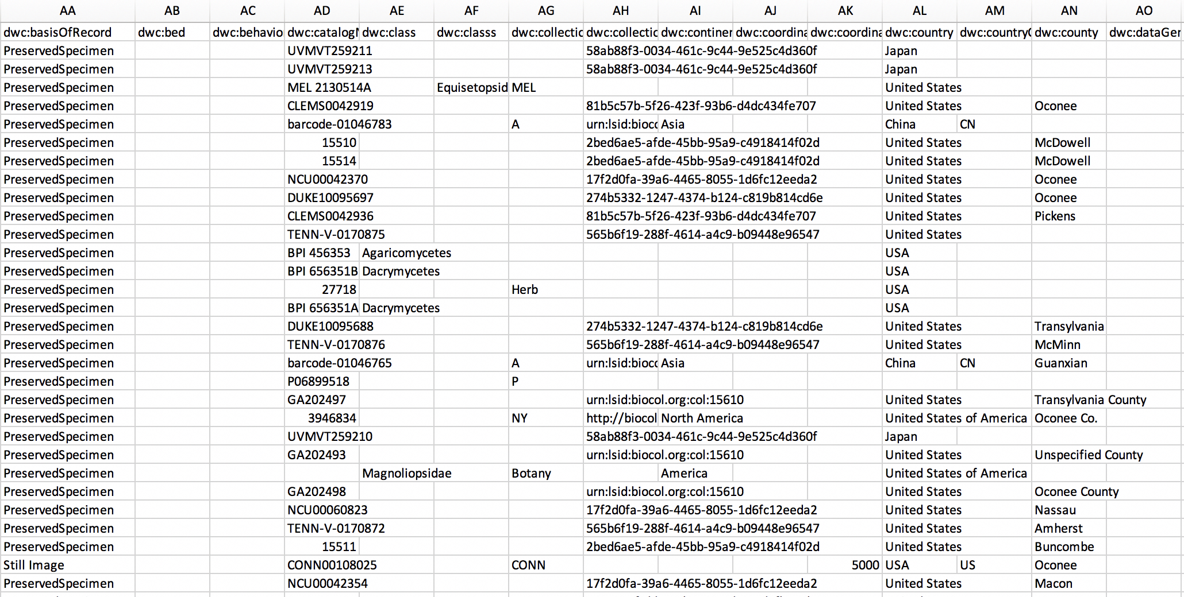
Producing a CSV File

Slide 11

🐊
Coming Soon…
Geographic And Taxonomic Occurrence R-based Scrubbing
(gatoRs):
An R Package and Reproducible Workflow for Processing Biodiversity Data
Natalie Patten, Shelly Gaynor, Doug Soltis, & Pam Soltis

Slide 12
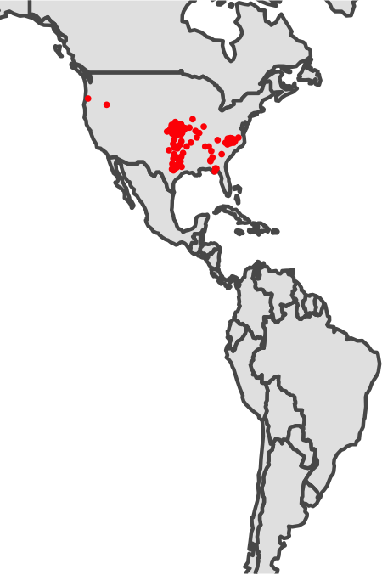
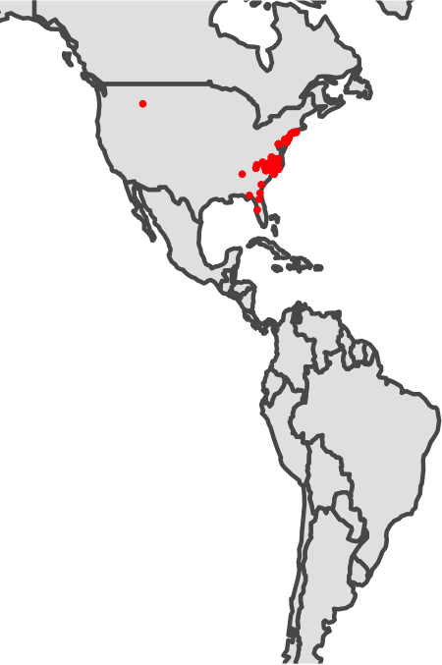
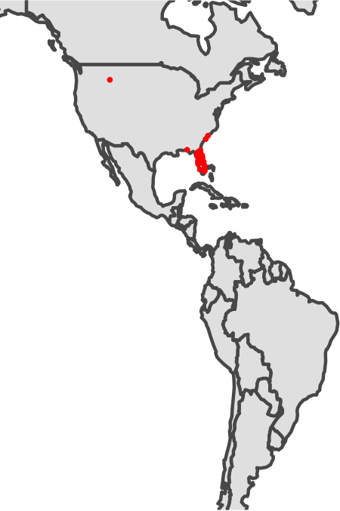
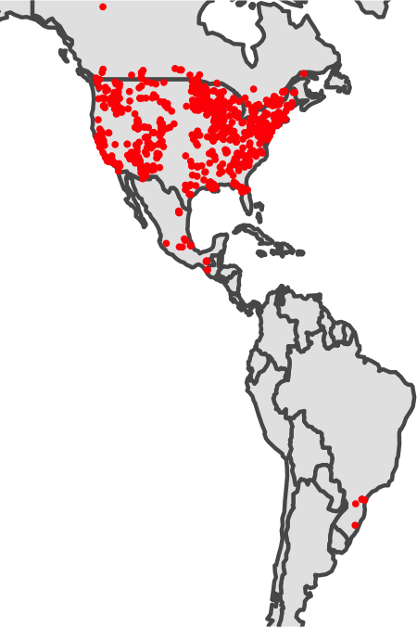
Outlier Detection
Abdra brachycarpa
Agalinis setacea
Ampelaster carolinianus
Acer negundo
From Tal Kinser

Slide 13
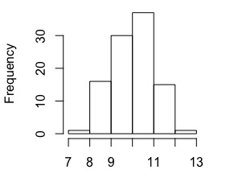
Finding Outliers in a Distribution
From Tal Kinser

Slide 14
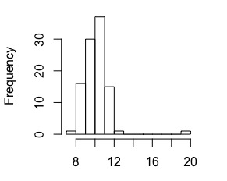
Finding Outliers in a Distribution
From Tal Kinser

Slide 15

Finding Outliers in a Distribution
Set a cut-off based on center and breadth of distribution
Mean +/- #SDs
Remove points outside
From Tal Kinser

Slide 16
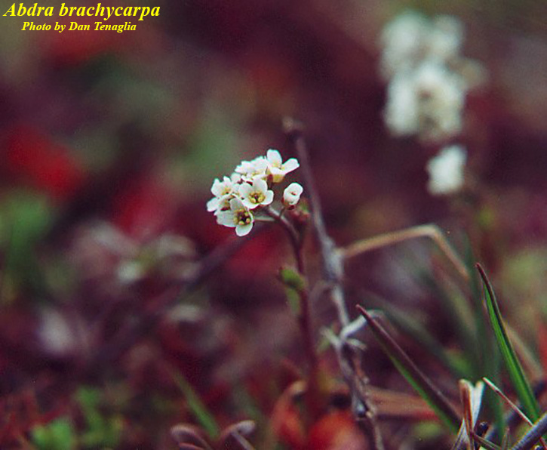
Creating a Distribution for Outlier Detection
with Spatial Data
Abdra brachycarpa
????
From Tal Kinser

Slide 17
Creating a Distribution for Outlier Detection
with Spatial Data
Calculate a centroid for data cloud
From Tal Kinser

Slide 18
Creating a Distribution for Outlier Detection
with Spatial Data: Finding the Centroid
Calculate a centroid for data cloud
Calculate distance to centroid for each point
From Tal Kinser

Slide 19
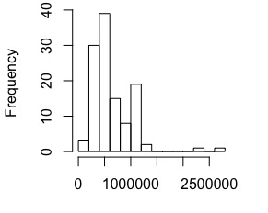
Creating a Distribution for Outlier Detection
with Spatial Data
Abdra brachycarpa
Create distribution of distance to centroid
From Tal Kinser

Slide 20
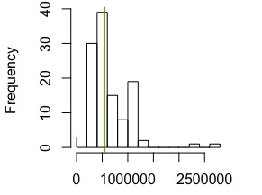
Creating a Distribution for Outlier Detection
with Spatial Data
From Tal Kinser

Slide 21
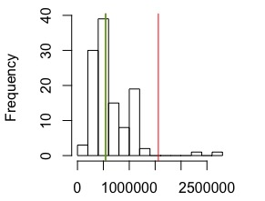
Creating a Distribution for Outlier Detection
with Spatial Data
From Tal Kinser

Slide 22
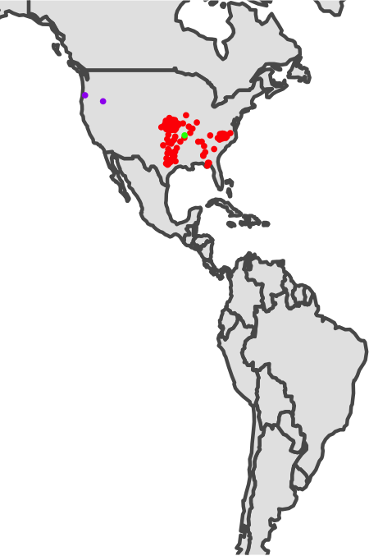

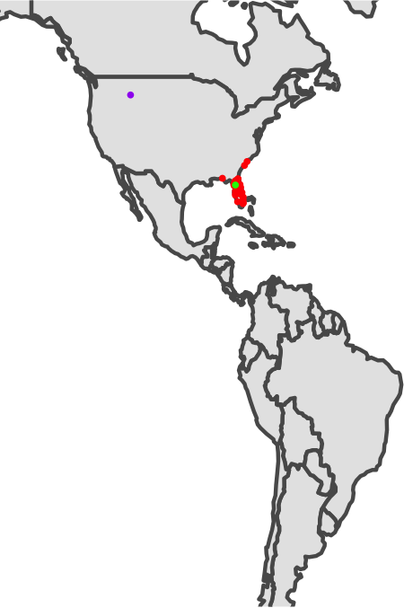
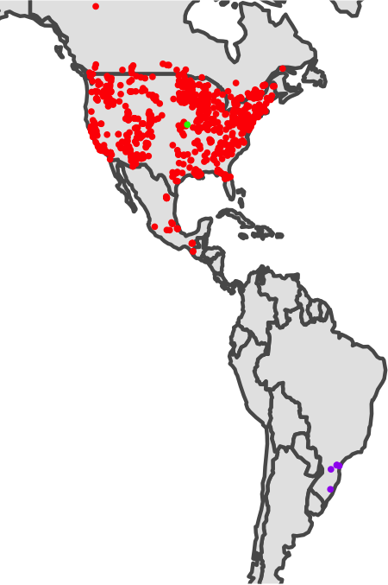
Outliers Successfully Identified – And Removed!
Abdra brachycarpa
Agalinis setacea
Ampelaster carolinianus
Acer negundo
From Tal Kinser

